Slide 1

Memory Forensics
A Practical Approach to Investigate Data Leakage with Volatility 2

Slide 2
Pre-investigation

Slide 3
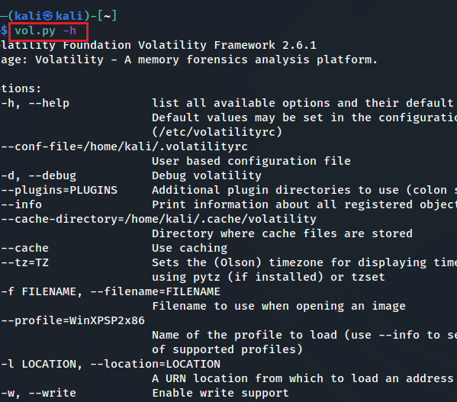
How to install Volatility 2?
If you have downloaded Kali from our GitHub, volatility has been pre-installed
You MUST use vol.py

Slide 4

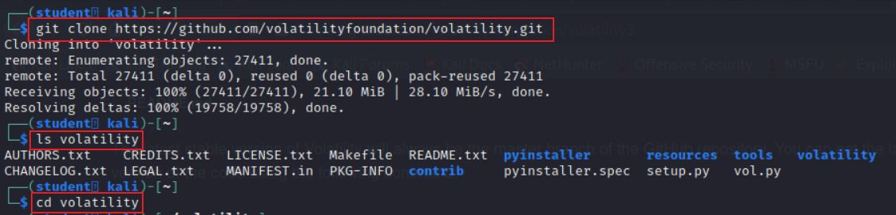
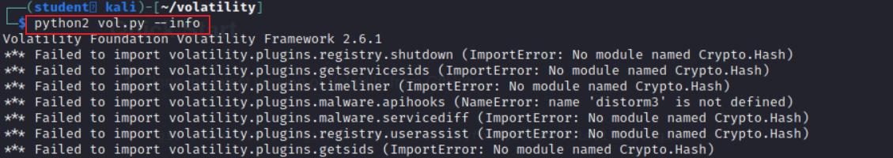
Manual install Volatility 2?
for all commands starting with volatility, you MUST replace them with python2 vol.py
for example, volatility -f memdumpWin7.mem imageinfo MUST changed to python2 vol.py -f memdumpWin7.mem
Notes:
git clone https://github.com/volatilityfoundation/volatility.git
cd volatility

Slide 5

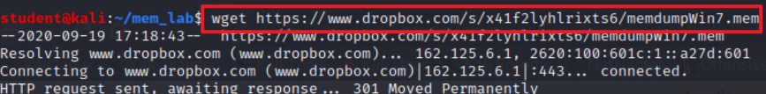
Where to download the memory image for investigations?
Download memory dump
Verify downloaded file
Notes:
wget https://www.dropbox.com/s/x41f2lyhlrixts6/memdumpWin7.mem

Slide 6
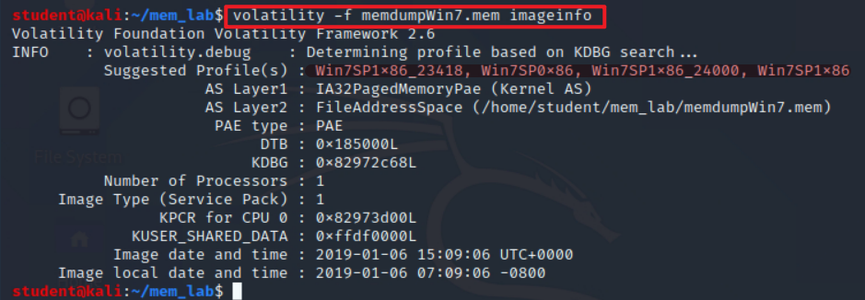
How to identify the image profile?
Use vol.py (NOT volatility) if you use the customized Kali from GitHub
Notes:
volatility -f memdumpWin7.mem imageinfo

Slide 7
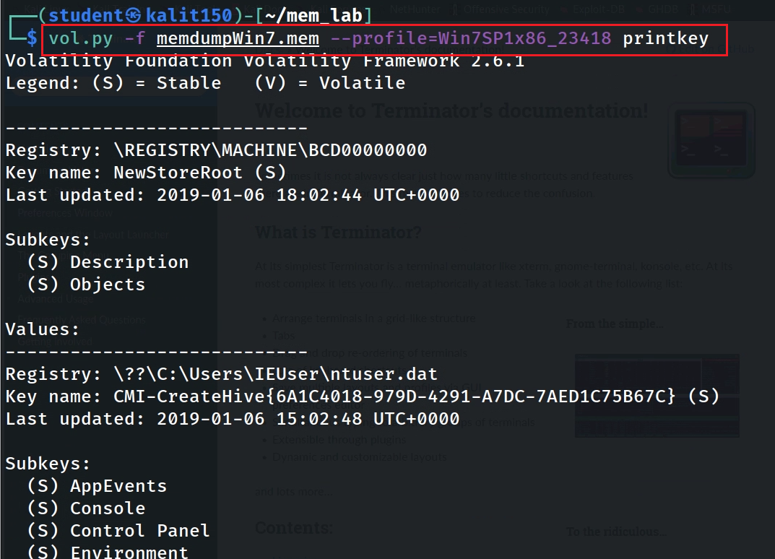
Show all registry keys
Notes:
vol.py -f memdumpWin7.mem --profile=Win7SP1x86_23418 printkey

Slide 8








Investigation
Understand the Suspect and Accounts
Understand the Suspect’s PC
Network Forensics
Investigate Command History
Investigate Suspect’s USB
Investigate Internet Explorer History
Investigate File Explorer History
Timeline Analysis

Slide 9
Understand the Suspect and Accounts

Slide 10
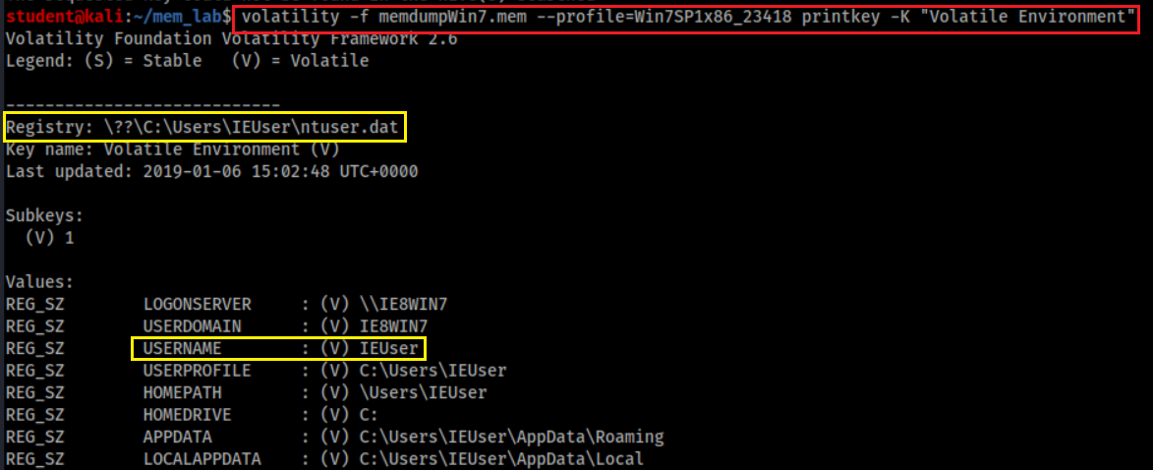
Who was using the device?
Physical file location = {subkeys of active user profile}
=HKEY_USERS \<SID> (linked to by HKEY_CURRENT_USER)
SID: Security Identifier: a unique, immutable identifier of a user, user group, or other security principal.
Users can change names but not SID
Notes:
vol.py -f memdumpWin7.mem --profile=Win7SP1x86_23418 printkey -K "Volatile Environment"

Slide 11
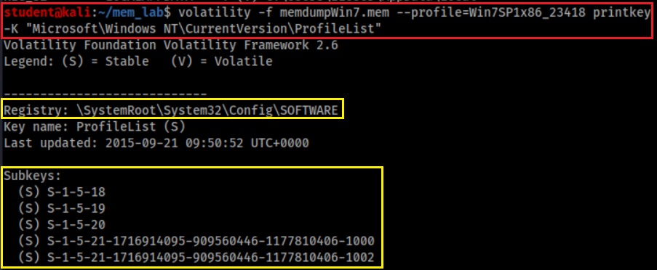
Who are associated with the device?
Sam – HKEY_LOCAL_MACHINE\SAM
Security – HKEY_LOCAL_MACHINE\SECURITY
Software – HKEY_LOCAL_MACHINE\SOFTWARE
System – HKEY_LOCAL_MACHINE\SYSTEM
Default – HKEY_USERS\.DEFAULT
Notes:
volatility -f memdumpWin7.mem --profile=Win7SP1x86_23418 printkey -K "Microsoft\Windows NT\CurrentVersion\ProfileList"

Slide 12
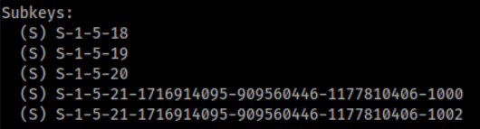
SID format details
S-1-5
S: SID
1: Version 1
5: Managed by the NT security subsystem
SID | Name | Description
S-1-5-18 | Local System | A service account that is used by the operating system.
S-1-5-19 | NT Authority | Local Service
S-1-5-20 | NT Authority | Network Service
S-1-5-21 | Administrator/Guest | A user account for the system administrator.

Slide 13
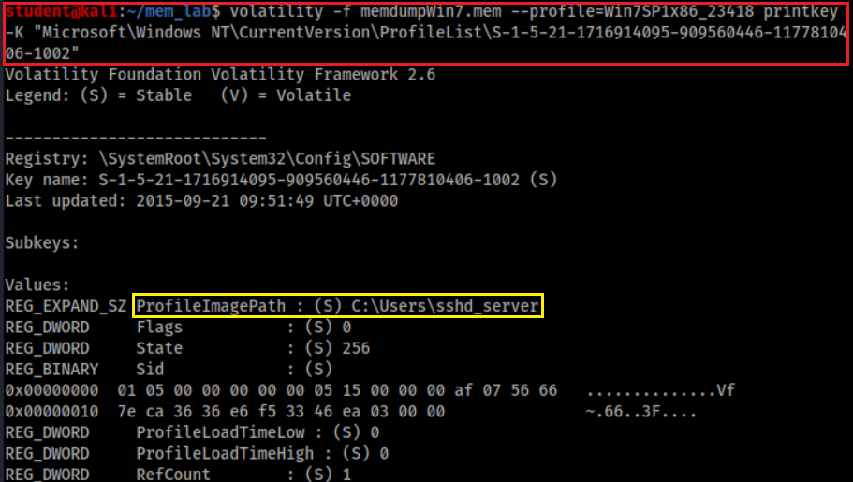
Who has SID= S-1-5-21-1716914095-909560446-1177810406-1002?
SSHD_Server is an account made by an SSH server.., It allows remotely log in to the computer.
Notes:
volatility -f memdumpWin7.mem --profile=Win7SP1x86_23418 printkey -K "Microsoft\Windows NT\CurrentVersion\ProfileList\S-1-5-21-1716914095-909560446-1177810406-1002"

Slide 14
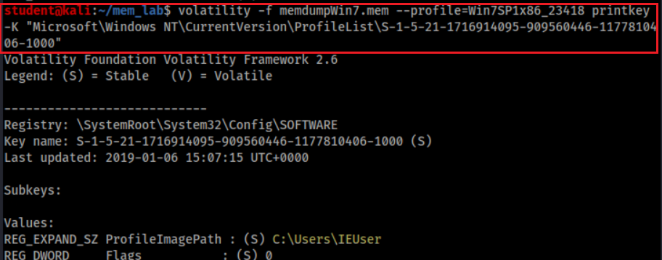
Who has SID= S-1-5-21-1716914095-909560446-1177810406-1000?
Notes:
volatility -f memdumpWin7.mem --profile=Win7SP1x86_23418 printkey -K "Microsoft\Windows NT\CurrentVersion\ProfileList\S-1-5-21-1716914095-909560446-1177810406-1000"

Slide 15
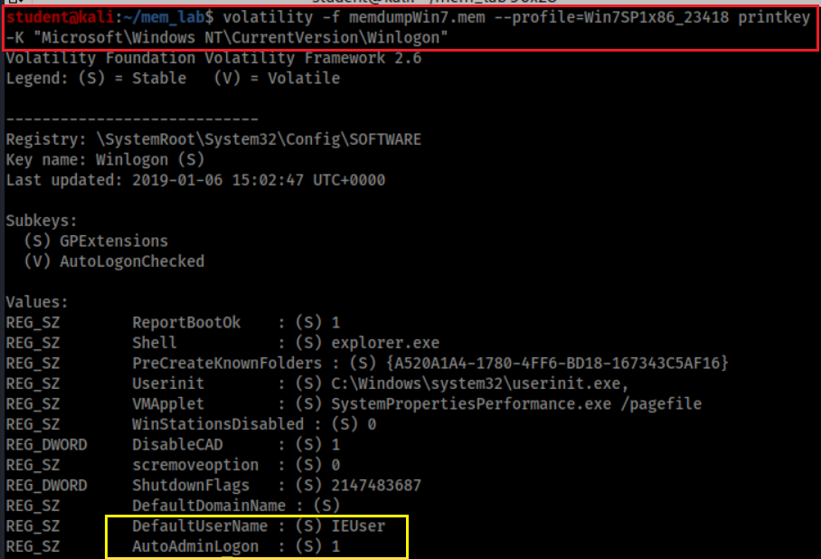
Who is the default logon user?
Default automatically log on

Slide 16
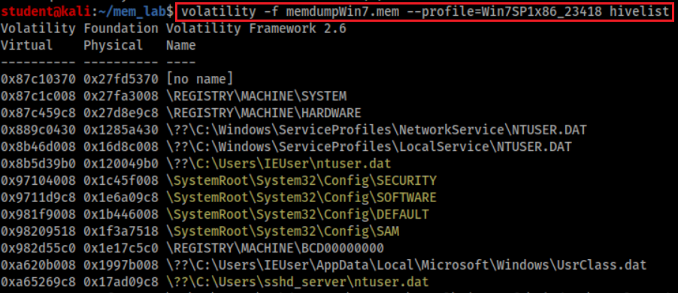
Hive overview
represents pointers to other hives, and is normal
Keys under HKLM\SYSTEM\CurrentControlSet\Control\hivelist
Point to HKEY_LOCAL_MACHINE\SYSTEM
Point to HKEY_LOCAL_MACHINE\HARDWARE
Each user has a profile (ntuser.dat)

Slide 17
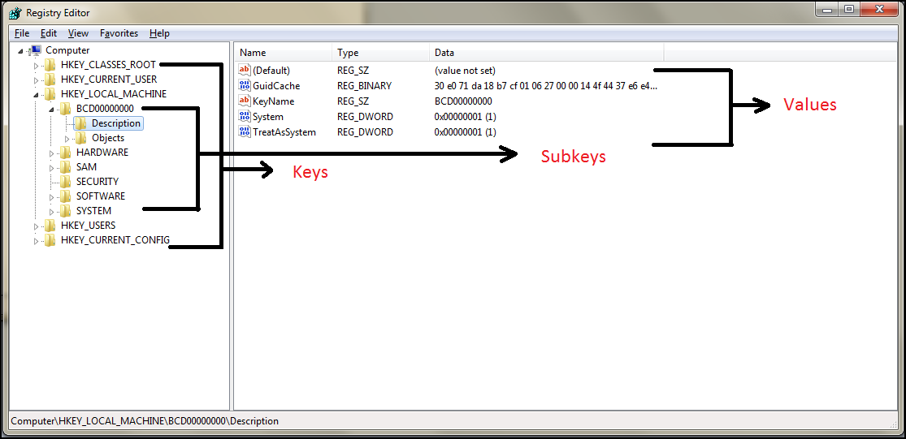
It is the time to review Registry
The five main root keys of registry are:
HKEY_CLASSES_ROOT (HKCR)
HKEY_CURRENT_USER (HKCU)
HKEY_LOCAL_MACHINE (HKLM)
HKEY_USERS (HKU)
HKEY_CURRENT_CONFIG (HKCC)

Slide 18
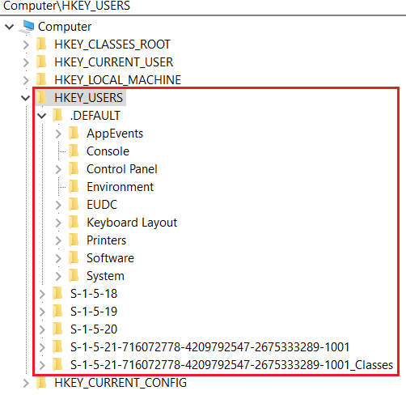
HKEY_USERS (HKU)
Contains information about all the users who logged in to the computer at some point
When log on, the current logged in user profile is linked by HKCU
Saved in each user's profile folder
C:\Users\IEUser\Ntuser.dat
C:\Users\ssh_Server\Ntuser.dat
C:\Users\Default User\Ntuser.dat
contains the base settings for new users when they first logon,

Slide 19
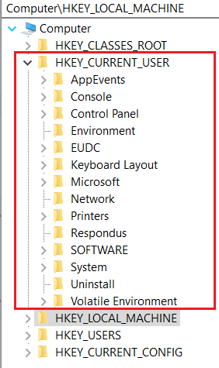
HKEY_CURRENT_USER (HKCU)
Does not contain any data
A link to the subkey of HKEY_USERS
Stores settings for currently logged-in use
Unloaded when the user logs out
If no profile is available, built from default user
Control everything of the current logged user
Environment variables
Desktop settings,
Network connections, printers,
Application preferences.
Keyboard layout
Current logged user information
Treasure for investigators

Slide 20
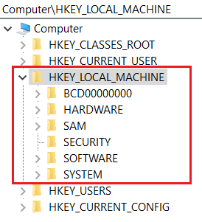
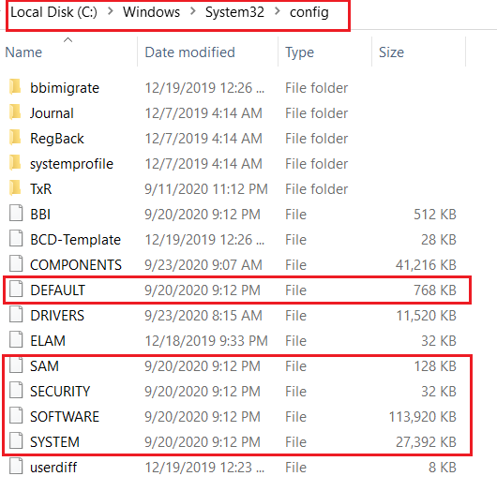
HKEY_LOCAL_MACHINE (HKLM)
Contains computer hardware and software information
Loaded at boot time from
Store Plug-and-Play devices Infor
Created dynamically, not stored in a file
Loaded at boot time from

Slide 21
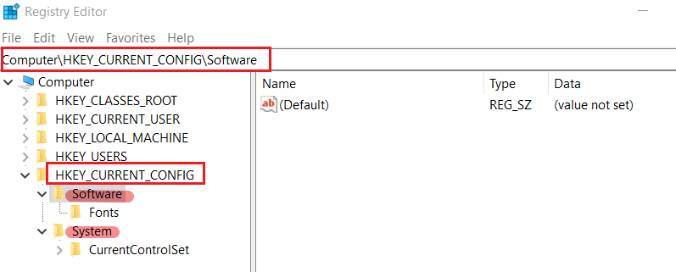
HKEY_CURRENT_CONFIG (HKCC)
It doesn't store any information itself but instead acts as a pointer, or a shortcut, to a registry key
Noting shown here, but points to other registry

Slide 22
Understand the Suspect’s PC

Slide 23
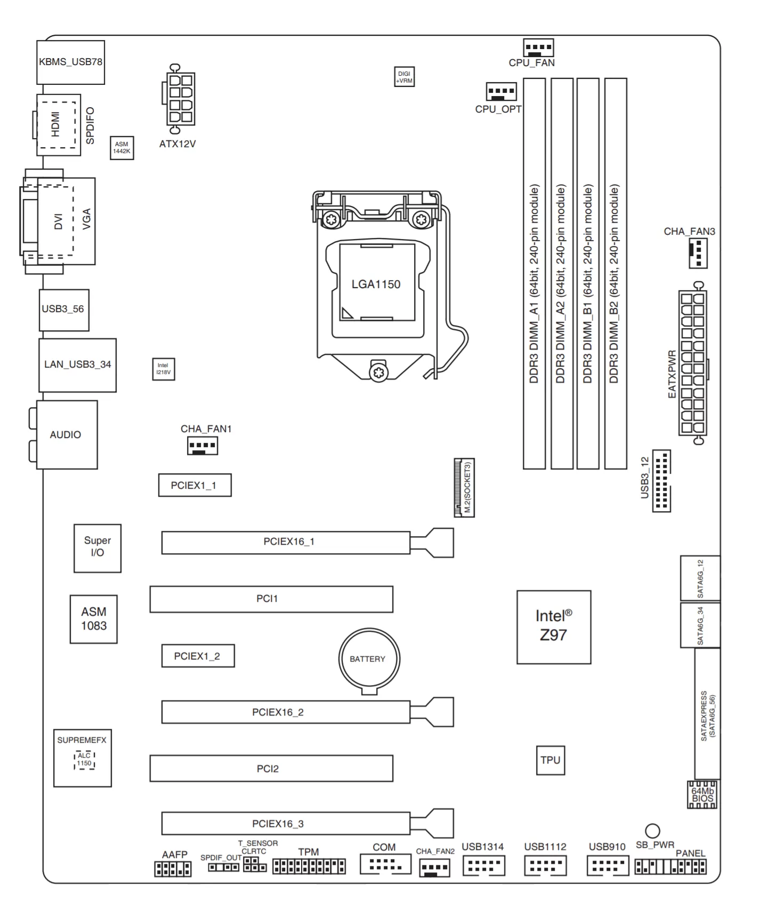
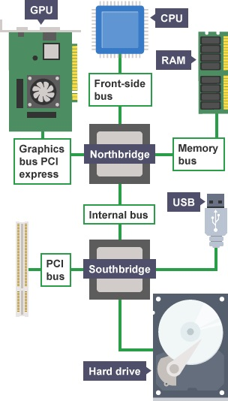
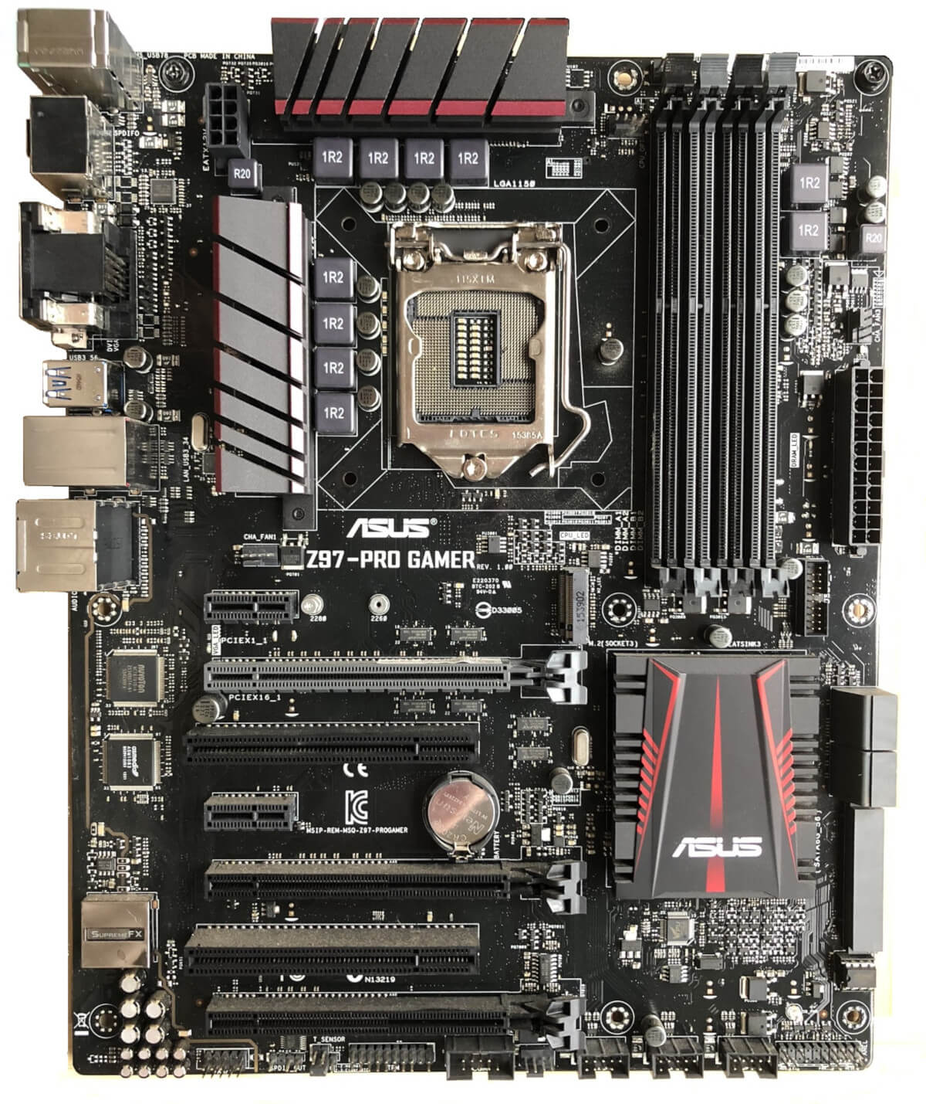
Motherboard layout
Peripheral Component Interconnect
Notes:
https://www.techspot.com/article/1965-anatomy-motherboard/
PCI is a parallel connection, and devices connected to the PCI bus appear to be a bus master to connect directly to its own bus. While PCIe card is a high-speed serial connection. Instead of one bus that handles data from multiple sources, PCIe has a switch that controls several point-to-point serial connections.

Slide 24
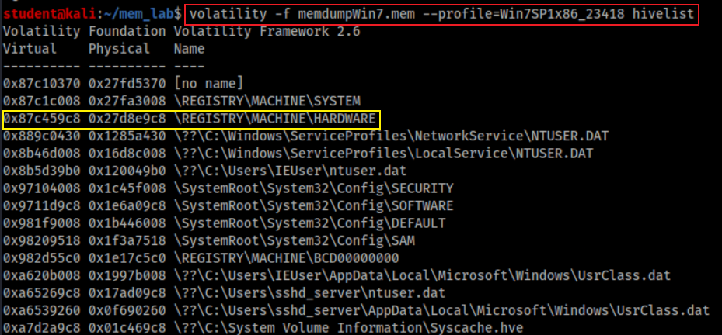
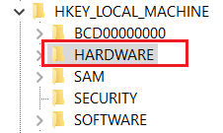
Where to find CPU of the Suspect’s PC?
Find hardware keys
Point to

Slide 25
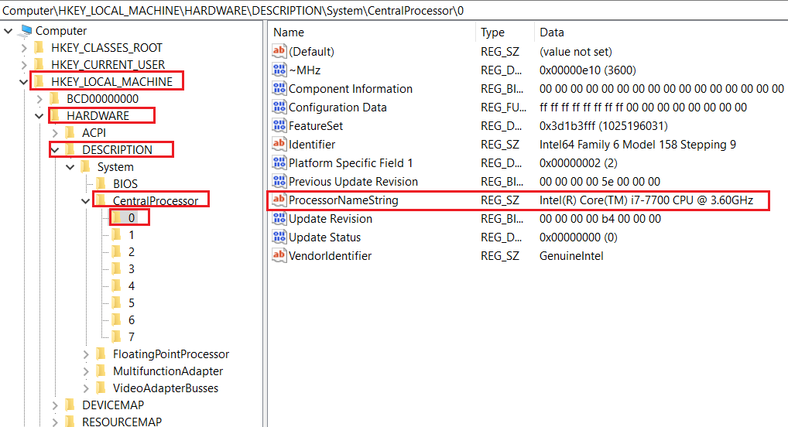
Find key = “DESCRIPTION\CentralProcessor\0”
If your system has multiple processors, they are all listed as subkeys under this key. If your system has only one processor, it is listed as processor 0.

Slide 26
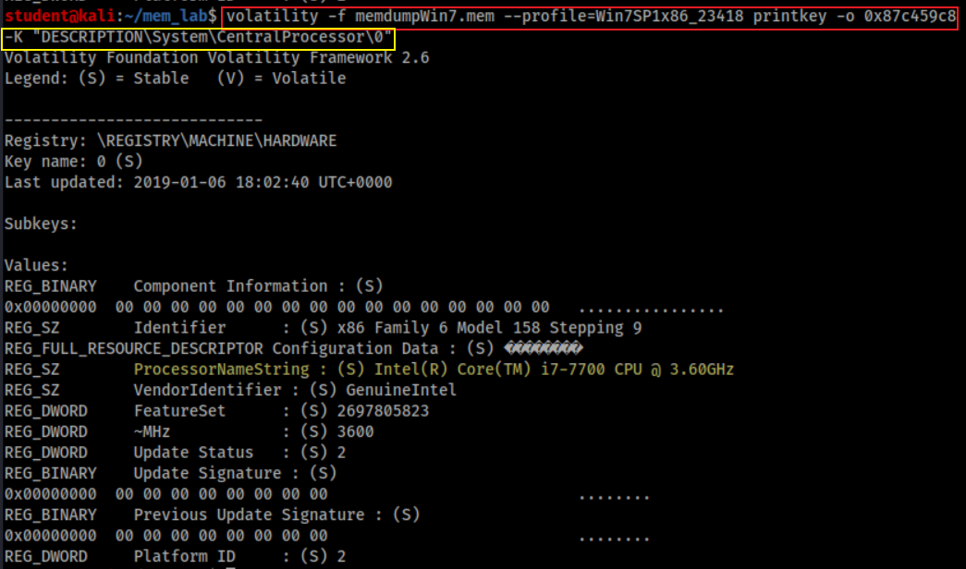
How to find CPU of the Suspect’s PC?
Print key starts from offset 0x87c459c8. Offset can be skipped

Slide 27
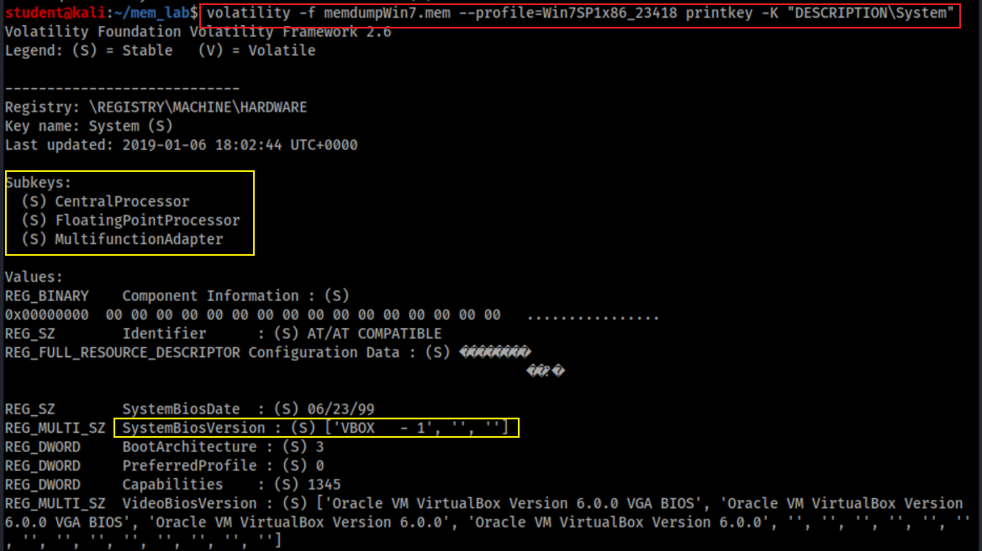
How to find other PC system information?
Show system board, system BIOS, and video BIOS, plus subkeys for the processors and bus controllers

Slide 28
How PC enumerates devices on its bus?
A bus driver services a bridge, bus controller, or adapter
A bus driver enumerates the devices on its bus
device's enumerator
Respond to Plug and Play I/O request packets (IRPs)

Slide 29
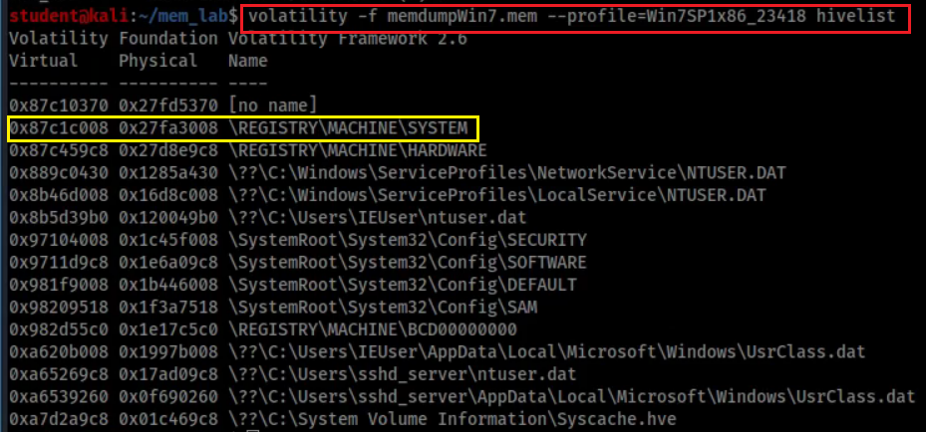
Where the enumerated devices Infor saved?

Slide 30
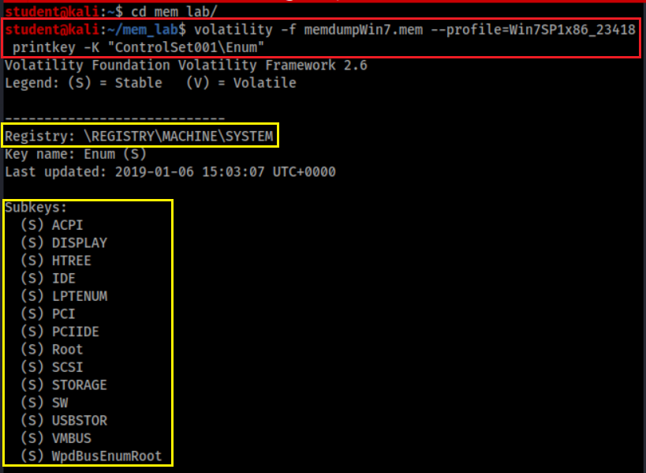
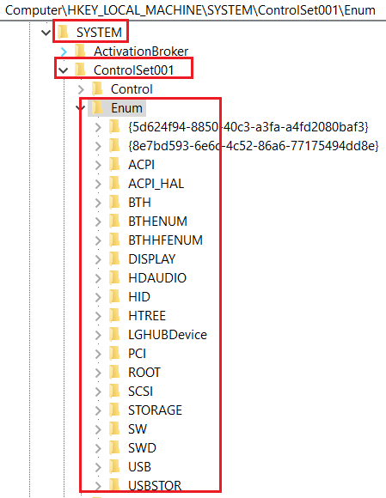
How to enumerated devices?
Enumerate devices

Slide 31
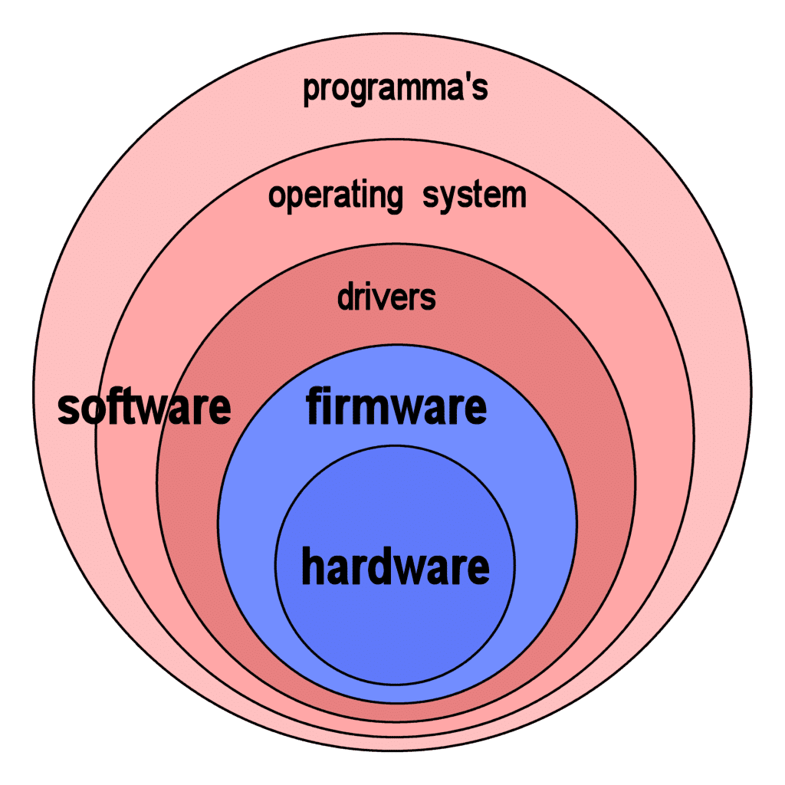
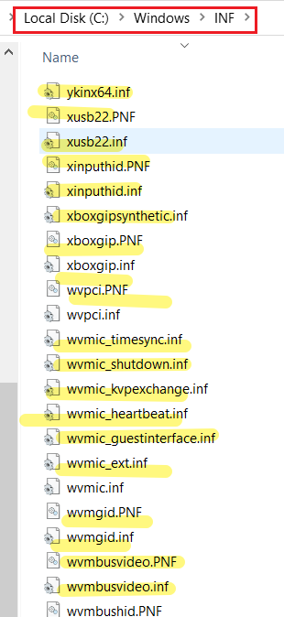
How Windows install device drivers?
Almost all electronic devices contain firmware
When plug-in, device's enumerator (e.g., PnP Bus Drivers)
Reports Device Identification Strings from device firmware
Hardware IDs - vendor-defined
Compatible IDs - vendor-defined
Windows uses Hardware IDs to
locate the information (INF) file that best matches the device
if not, uses compatible IDs
Windows uses INF file to install device drivers

Slide 32
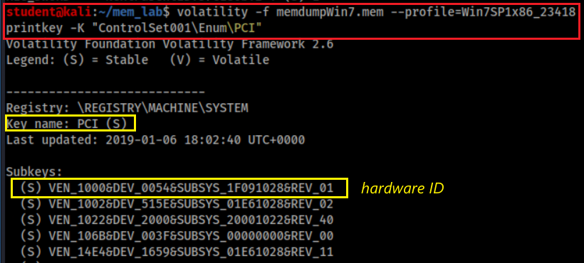
How to find devices connected to PCI?
VEN_XXXX: vendor
DEV_XXXX: model of device
Common VEN_XXXX codes:
Intel – 8086
ATI/AMD – 1002/1022
NVIDIA – 10DE
Broadcom – 14E4
Atheros – 168C
Realtek – 10EC
Creative – 1102
Logitech – 046D

Slide 33
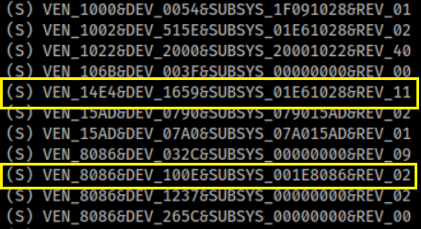
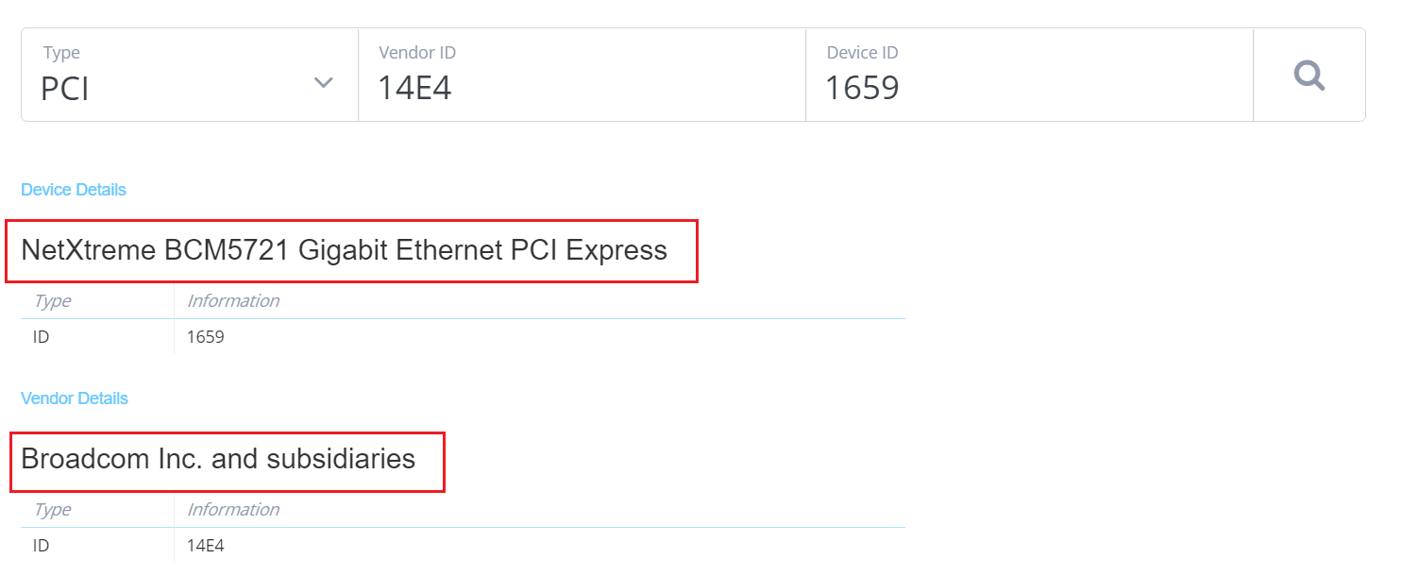
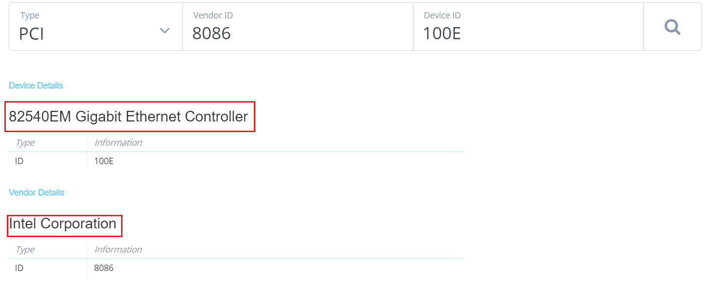
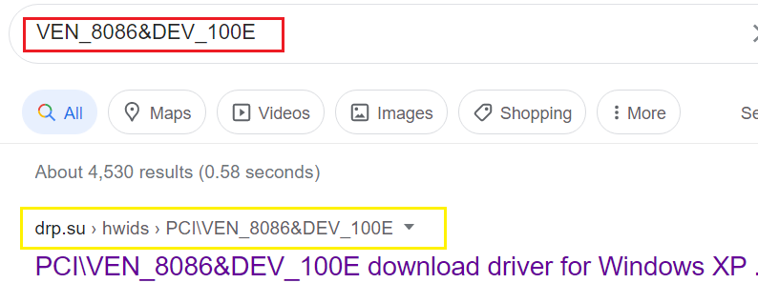
Search device: https://devicehunt.com/
Search driver based on hardware ID

Slide 34
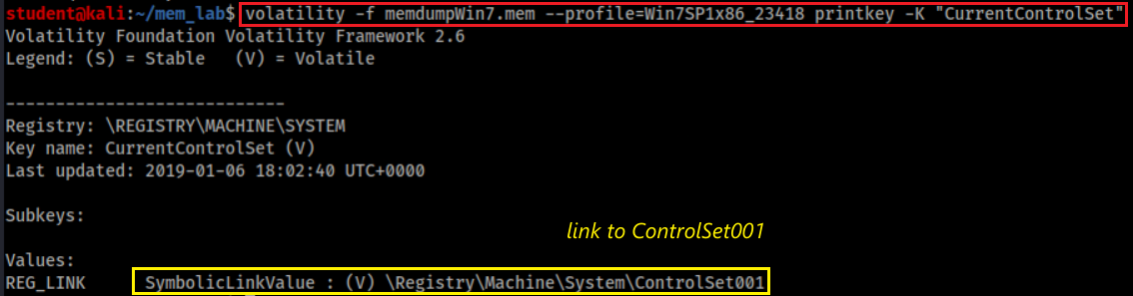
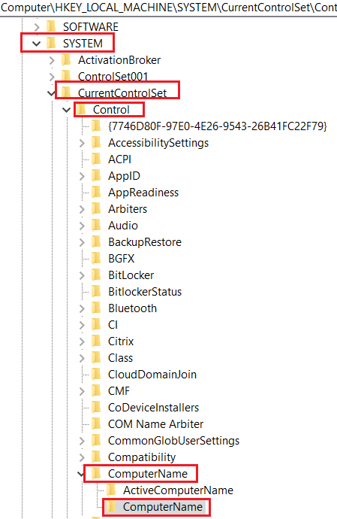
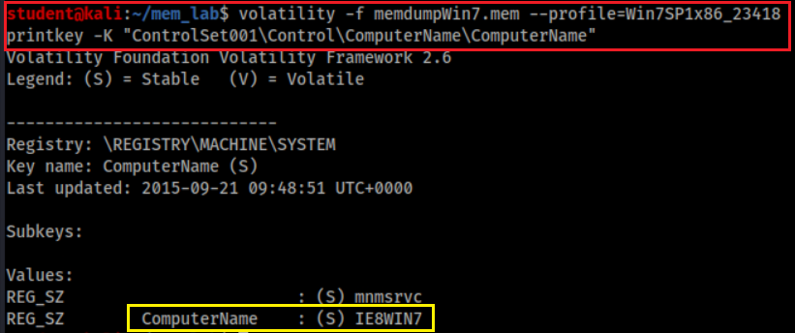
What is the name of suspect’s device?
Note: On a live registry, you will see “CurrentControlSet” instead of “ControlSet001”. Because it is not a live, we need to check ControlSet001
link to
Notes:
volatility -f memdumpWin7.mem --profile=Win7SP1x86_23418 printkey -K "ControlSet001\Control\ComputerName"

Slide 35
Network Forensics

Slide 36
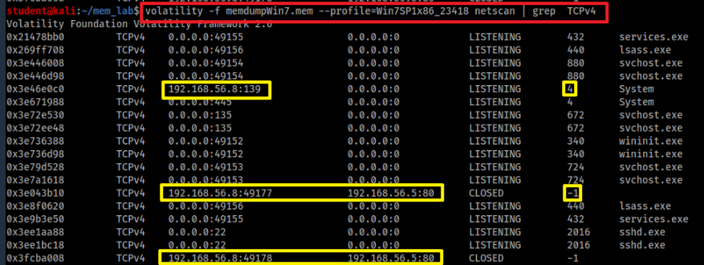
Are there suspicious IPs (processes) connected to the PC?
Scan network objects
grep: only show TCP

Slide 37
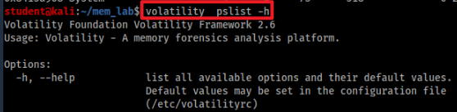
Which program that was connected to this suspicious IP address?
Find out process name of 4
Help command
Note: Module Output Options: dot, greptext, html, json, sqlite, text, xlsx

Slide 38
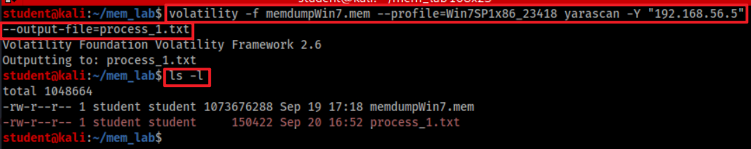
Which program that was connected to this suspicious IP address?
Find out process name of -1 (unidentified process) using the suspicious IP
-Y “192.168.56.5”: Define YARA pattern at IP
--output-file=any file name
YARA is a tool aimed at (but not limited to) helping malware researchers to identify and classify malware samples.

Slide 39
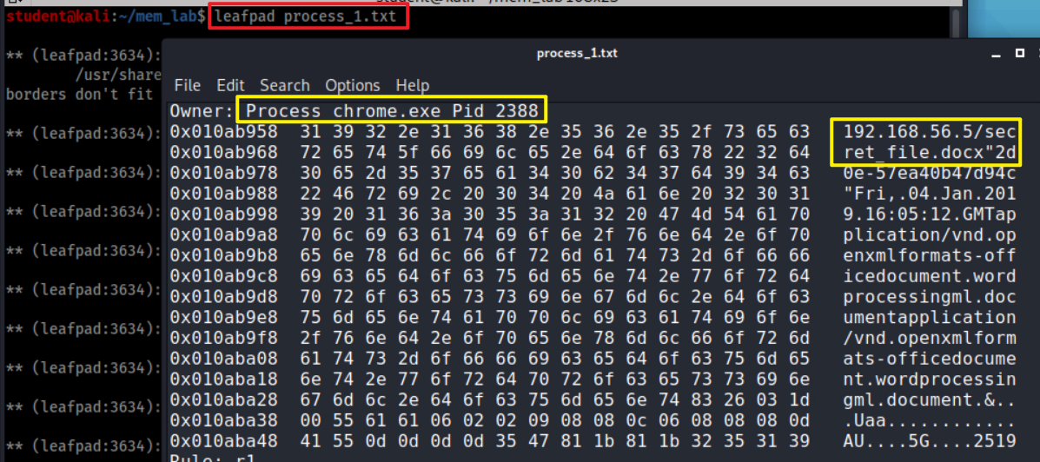
Find the application chrome.exe which PID=2388
The suspect used chrome to download file

Slide 40
Investigate Command History
cmdscan and consoles

Slide 41
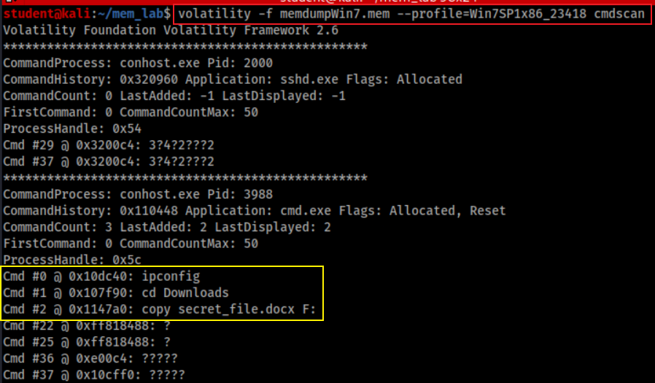
Did the suspect use commands to copy files?
Is F drive a USB?

Slide 42
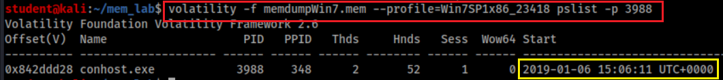
When these commands are executed?
Need to find timestamps because the PID of Command Prompt
Command PID

Slide 43
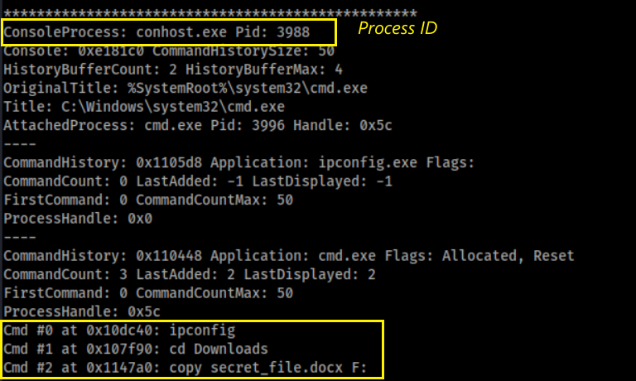
An alternate method to search command history
Process and PID found

Slide 44
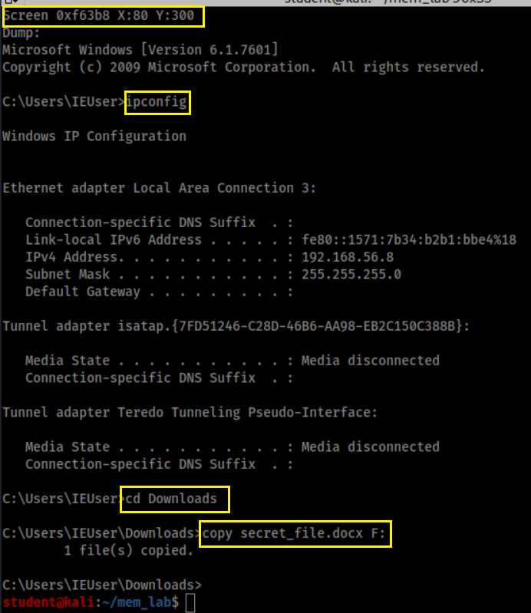
Screen captured

Slide 45
Investigate Suspect’s USB

Slide 46
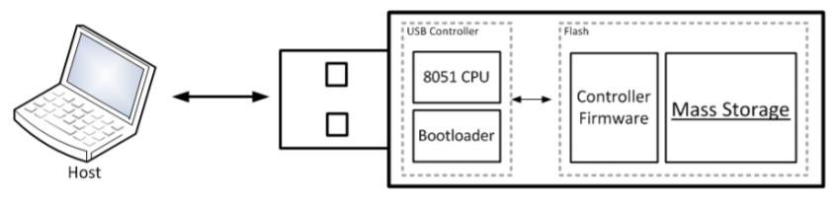
How a PC recognizes a USB?
USB Mass Storage device Class (MSC) communication protocols
When a USB is plugged in, the Plug and Play (PnP) Manager finds device ID (Hardware IDs or Compatible IDs)
Receives the event => enumerates devices from firmware=> device ID
OS locates the appropriate driver for the device
Queries the device descriptor (.inf) uses Hardware IDs or Compatible IDs
OS loads that driver use .inf
Once the device has been identified
Multiple registry keys will be generated

Slide 47

Generated registry keys can be used as evidence chain
Show a USB was attached to a PC
A USB has an unique Instance ID of each device
The USB has been assigned a drive letter (D, E, F..) of the PC
The drive letter is associated with a suspect’s account
Timestamps need to be verified
Check setupapi.log (if available)

Slide 48
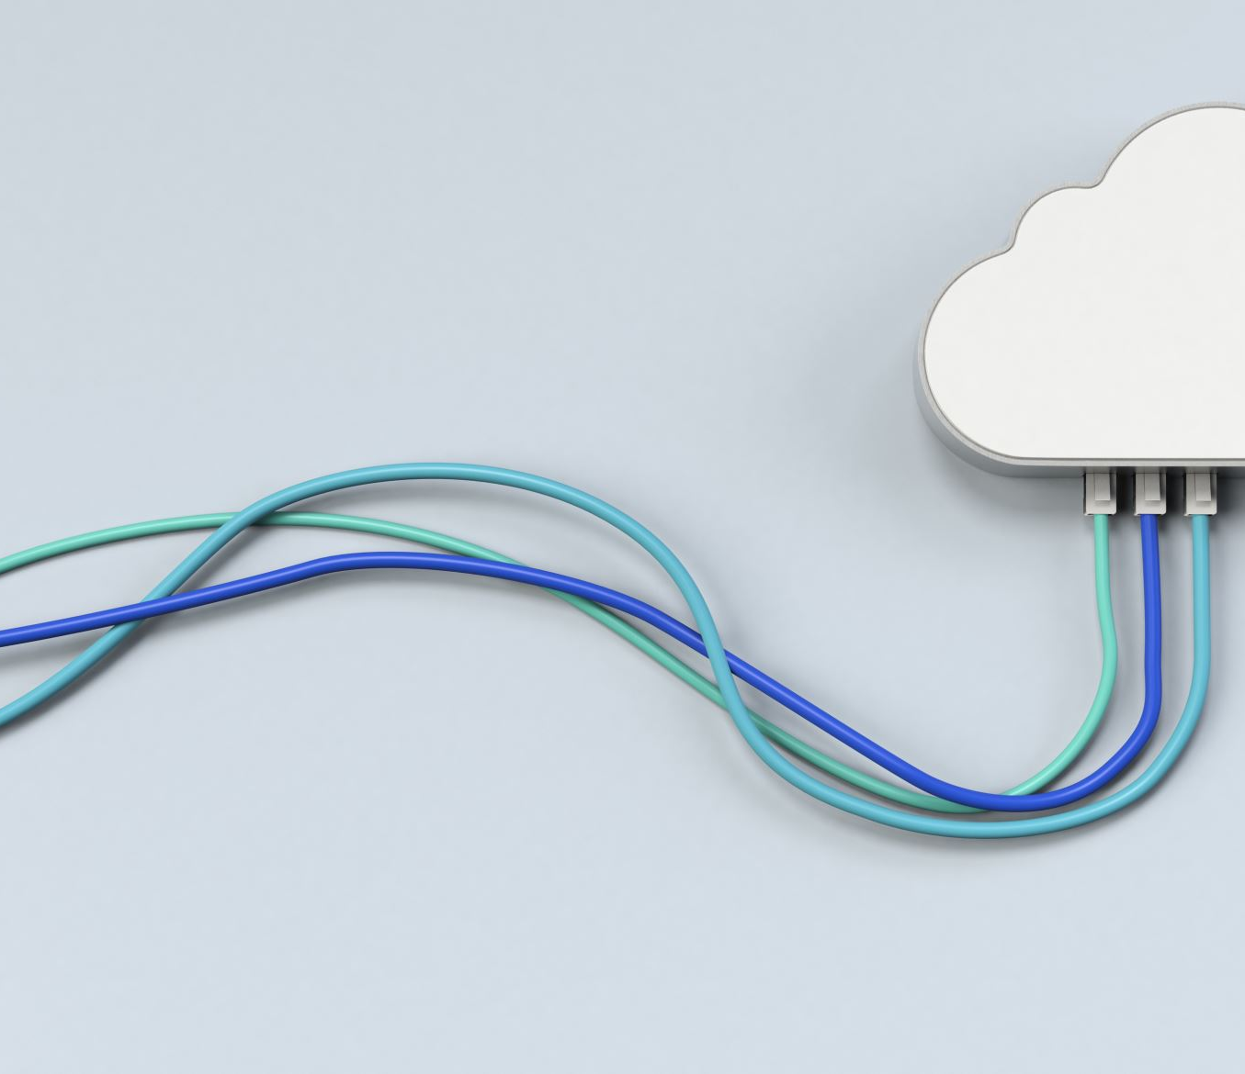
Show a USB was attached to a PC
USB Device interface key is add under
HKEY_LOCAL_MACHINE\SYSTEM\ControlSet001\Control\DeviceClasses
USB Device interface key have a link to
USBSTOR\Disk&Ven_General&Prod_UDisk&Rev_5.00

Slide 49


What is a Device interface GUID?
Each device has an interface with a Globally Unique Identifier (GUID)
To communicate with PC
Organized under DeviceClasses
A device interface subkey is created when a plug and play device driver is successfully loaded.
Disk interface subkey: GUID_DEVINTERFACE_DISK, or DiskClassGUID
Value=53F56307-B6BF-11D0-94F2-00A0C91EFB8B
The subkey will be removed if the device is removed
a hard disk storage (e.g., USB) device interface
Notes:
https://docs.microsoft.com/en-us/windows-hardware/drivers/install/guid-devinterface-disk
https://www.sciencedirect.com/topics/computer-science/removable-storage-device
https://docs.microsoft.com/en-us/previous-versions//ff553412(v=vs.85)?redirectedfrom=MSDN
53F56307-B6BF-11D0-94F2-00A0C91EFB8B

Slide 50

List all device interfaces
Disk interfaces
Notes:
{53f56307-b6bf-11d0-94f2-00a0c91efb8b}

Slide 51

List Disk Interfaces
#USBSTOR
#Disk
&Ven_[VendorName]
&Prod_[ProductName]
&Rev_[RevisionID]
#[UID/SerialNo.]
#{DeviceInterfaceClassID}.
Notes:
volatility -f memdumpWin7.mem --profile=Win7SP1x86_23418 printkey -K "ControlSet001\Control\DeviceClasses\{53f56307-b6bf-11d0-94f2-00a0c91efb8b}"

Slide 52
Other Useful disk interfaces (1)
Tableau connected via Firewire: ##?#SBP2#Tableau&Forensic_SATA_Bridge&LUN0&REV15#000ecc01000f4063#{53f56307-b6bf-11d0-94f2-00a0c91efb8b}
eSATA attached SSD: ##?#IDE#DiskPatriot_Torqx_2_32GB_SSD________________S5FAM014#4&35e86db3&0&0.2.0#{53f56307-b6bf-11d0-94f2-00a0c91efb8b}
F-Response iSCSI disk: ##?#SCSI#Disk&Ven_FRES&Prod_FRES#1&1c121344&0&000000#{53f56307-b6bf-11d0-94f2-00a0c91efb8b}
External non generic USB Disk: \##?#USBSTOR#Disk&Ven_FUJITSU&Prod_MHT2060AH&Rev_#43527242060A&0#{53f56307-b6bf-11d0-94f2-00a0c91efb8b}
External generic USB Disk: ##?#USBSTOR#Disk&Ven_&Prod_&Rev_PMAP#07032AE8AFBE2481&0#{53f56307-b6bf-11d0-94f2-00a0c91efb8b}
Notes:
https://www.hecfblog.com/2013/08/daily-blog-67-understanding-artifacts.html

Slide 53
Other Useful disk interfaces (2)
USB attached android phone: ##?#USBSTOR#Disk&Ven_Android&Prod___UMS_Composite&Rev___00#8&d3cc3f0&0&304D1905736FB98E&0#{53f56307-b6bf-11d0-94f2-00a0c91efb8b}
Volume GUIDs: SYSTEM\\Control\DeviceClasses\{53F5630D-B6BF-11D0-94F2-00A0C91EFB8B}
MagicISO mounted image: ##?#SCSI#CdRom&Ven_MagicISO&Prod_Virtual_DVD-ROM&Rev_1.0A#1&2afd7d61&0&0000#{53f5630d-b6bf-11d0-94f2-00a0c91efb8b}
Volume of the generic USB storage device: ##?#STORAGE#VOLUME#_??_USBSTOR#DISK&VEN_&PROD_&REV_PMAP#07032AE8AFBE2481&0#{53F56307-B6BF-11D0-94F2-00A0C91EFB8B}#{53f5630d-b6bf-11d0-94f2-00a0c91efb8b}

Slide 54

Access DeviceClass\Disk Interface\USB Interface
Notes:
volatility -f memdumpWin7.mem --profile=Win7SP1x86_23418 printkey -K "ControlSet001\Control\DeviceClasses\{53f56307-b6bf-11d0-94f2-00a0c91efb8b}\##?#USBSTOR#Disk&Ven_General&Prod_UDisk&Rev_5.00#6&1bec0f48&0&_&0#{53f56307-b6bf-11d0-94f2-00a0c91efb8b}"

Slide 55

Access DeviceClass\Disk Interface\USB Interface\# SymbolicLink
USB plug-in timestamp
It is a symbolic link, we can check and verify the subkey
Notes:
volatility -f memdumpWin7.mem --profile=Win7SP1x86_23418 printkey -K "ControlSet001\Control\DeviceClasses\{53f56307-b6bf-11d0-94f2-00a0c91efb8b}\##?#USBSTOR#Disk&Ven_General&Prod_UDisk&Rev_5.00#6&1bec0f48&0&_&0#{53f56307-b6bf-11d0-94f2-00a0c91efb8b}\#"

Slide 56


Verify USBTOR subkey and timestamp
USB Storage
Same timestamp
Ven_ [vendor name]
Prod_[product name assigned by vendor]
Rev_[revision ID]
Can we find Vendor ID and Product ID?
Notes:
volatility -f memdumpWin7.mem --profile=Win7SP1x86_23418 printkey -K "ControlSet001\Enum\USBSTOR"

Slide 57
How to find Vendor ID and Product ID?
When a USB device is connected to a Windows PC, Windows will remember its vendor and class IDs to reference the next time it is plugged in. This information is stored in:
HKEY_LOCAL_MACHINE\SYSTEM\CurrentControlSet\Enum\USB
E.g., Vid_0c55&Pid_5416
Can search device information
https://www.the-sz.com/products/usbid/
Note: Registry dumped from memory doesn’t have VID and PID
Normal registry will contain these information

Slide 58

What is the Instance ID of USB?
A device identification string that distinguishes a device from other devices of the same type on a computer.
the second character is &, means
the USB doesn’t provide SN
UID is created by PnP, is only unique system wide
Notes:
volatility -f memdumpWin7.mem --profile=Win7SP1x86_23418 printkey -K "ControlSet001\Enum\USBSTOR\Disk&Ven_General&Prod_UDisk&Rev_5.00“
Although a unique serial number is required for devices that manufacturers want to qualify for the Windows Logo program (www.microsoft.com/whdc/archive/usbfaq.mspx#ERCAC), not all devices include a serial number. For devices that do not have a serial number, the PnP Manager will create a unique instance ID for that device(6&1bec0f48&0&_&0)

Slide 59


What is the friendly name of the USB?
Note: It is hardware, difference from Disk interface GUID, which is software
Notes:
volatility -f memdumpWin7.mem --profile=Win7SP1x86_23418 printkey -K "ControlSet001\Enum\USBSTOR\Disk&Ven_General&Prod_UDisk&Rev_5.00\6&1bec0f48&0&_&0“
ClassGuid = {4d36e967-e325-11ce-bfc1-08002be10318}
https://docs.microsoft.com/en-us/windows-hardware/drivers/install/system-defined-device-setup-classes-reserved-for-system-use

Slide 60


What is ContainerID?
A system-supplied device identification string
Groups the functional devices associated with a single-function or multifunction device installed in the computer.
Introduced in Windows 7
the Plug and Play (PnP) manager uses the container ID to group one or more device
All physical devices should be assigned a ContainerID – not just storage devices.
monitors, external speakers, keyboards

Slide 61



Which drive letter does the USB was assigned to?
Notes:
volatility -f memdumpWin7.mem --profile=Win7SP1x86_23418 printkey -K "MountedDevices"

Slide 62

Problem of only exam /System/MountedDevices
The registry key may not have a correct drive letter.
Windows only tracks the last device that has been assigned a particular drive letter (D, E, F, etc.)
We need to exam NTUSER.DAT
Next slide

Slide 63


Who did mount F volume to PC?
Notes:
volatility -f memdumpWin7.mem --profile=Win7SP1x86_23418 printkey -K "Software\Microsoft\Windows\CurrentVersion\Explorer\MountPoints2"

Slide 64

When the USB Last Attached to PC?
Notes:
volatility -f memdumpWin7.mem --profile=Win7SP1x86_23418 printkey -K "Software\Microsoft\Windows\CurrentVersion\Explorer\MountPoints2\F"

Slide 65
USB Evidence Source List
SYSTEM/CurrentControlSet/Enum/USBSTOR
Referened by SYSTEM\ControlSet001\Control\DeviceClasses\{53f56307-b6bf-11d0-94f2-00a0c91efb8b}\UID\
SYSTEM/MountedDevices
Drive letter or volume mounted
NTUSER.DAT/Software/Microsoft/Windows/CurrentVersion/Explorer/MountPoints2
eveal which user was logged in and active
SYSTEM/CurrentControlSet/Enum/USB
Not available in memory dump
(optional) Windows Vista+ – ROOT/Windows/inf/setupapi.dev.log
(optional) Windows XP – ROOT/Windows/setupapi.log

Slide 66
Investigate Internet History

Slide 67

Did the suspect use Internet Explore?
IE history/cache
Control X: exit
Notes:
vol.py -f memdumpWin7.mem --profile=Win7SP1x86_23418 iehistory

Slide 68
Are there any activates in 2019? No
Notes:
volatility -f memdumpWin7.mem --profile=Win7SP1x86_23418 iehistory | grep 2019

Slide 69

Investigate File Explorer History
Shellbags

Slide 70
What are Shellbags?
Registry keys to track a folder window when viewed through File Explorer;
views, sizes and positions
includes network folders and removable devices
available since Windows XP
Giving the investigator great insight into
the folder
browsing history of a suspect
details for any folder that might no longer exist on a system
due to deletion, or being located on a removable device
Note: shellbags only get created when accessing the folders
copying, moving, deleted, etc. will not change anything.
Notes:
https://www.magnetforensics.com/blog/forensic-analysis-of-windows-shellbags/

Slide 71

What are registry keys that shellbags are structured from?
Structured from two main registry keys
BagMRU: stores folder names and records folder paths by creating the similar tree structure.
Bags: stores the view preferences such as the window size, location and view mode
Physical location (Win7 +)
%UserProfile%\NTUSER.dat
%UserProfile%\AppData\Local\Microsoft\Windows\UsrClass.dat.

Slide 72

How shellbags are structured?
Structured In hierarchy to which they are accessed through Windows Explorer
each numbered folder representing a parent or child folder of the one previous.
Notes:
https://www.sans.org/reading-room/whitepapers/forensics/windows-shellbag-forensics-in-depth-34545

Slide 73

Are there any folder access activities on 2019-01-06?
Interesting! we need to look into it.
Notes:
volatility -f memdumpWin7.mem --profile=Win7SP1x86_23418 shellbags | grep "Last updated: 2019-01-06" | sort
Last updated: 2019-01-06 14:32:21 UTC+0000
Last updated: 2019-01-06 14:32:53 UTC+0000
Last updated: 2019-01-06 14:55:45 UTC+0000
Last updated: 2019-01-06 15:04:40 UTC+0000
Last updated: 2019-01-06 15:04:40 UTC+0000
Last updated: 2019-01-06 15:04:40 UTC+0000
Last updated: 2019-01-06 15:07:03 UTC+0000

Slide 74


What are folder access activities on 2019-01-06?
Print shellbags to a file shellbags.html
Easy to review html files
Verify shellbags.html has be generated

Slide 75

A suspect accesses the download folder (twice).
First Access folder
Last Access of folder or last preference change, not the time of changing the files in the folder
Notes:
https://www.sans.org/blog/computer-forensic-artifacts-windows-7-shellbags/

Slide 76
Timeline Analysis

Slide 77

Chrome.exe downloads
2019-01-04 16:05:12 GMT
First review download folder
2019-01-06 14:49:40 UTC
USB plugged in
2019-01-06 15:02:54 UTC

Slide 78
USB assigned to F volume
2019-01-06 15:03:06 UTC
Last review download folder: 2019-01-06 15:04:40 UTC
Command Prompt with Copy command:
2019-01-06 15:06:011 UTC

Slide 79
Chrome.exe downloads:
2019-01-04 16:05:12
First review download folder
: 2019-01-06 14:49:40 UTC
USB plugged in: 2019-01-06 15:02:54 UTC
USB assigned to F volume: 2019-01-06 15:03:06 UTC
Command Prompt with Copy command
: 2019-01-06 15:06:11 UTC
Last review download folder
: 2019-01-06 15:04:40 UTC

Slide 80
Note
When a folder is deleted, the correspondent ShellBag registry keys and values will not be removed.
However, several tools have been developed to remove the ShellBag information from the registry.

Slide 81

Post-Investigation

Slide 82
What is Windows 7 password?
Dump password hashes from memory
Using John the Ripper to crack password
John the Ripper is a free password cracking software tool.
password.lst is the default password dictionary

Slide 83


Dump NTLM hash
The password to your VM IEUser is "Passw0rd!"
Save IEUser’s password hash to a file
Notes:
Administrator:500:aad3b435b51404eeaad3b435b51404ee:fc525c9683e8fe067095ba2ddc971889:::
Guest:501:aad3b435b51404eeaad3b435b51404ee:31d6cfe0d16ae931b73c59d7e0c089c0:::
IEUser:1000:aad3b435b51404eeaad3b435b51404ee:fc525c9683e8fe067095ba2ddc971889:::
sshd:1001:aad3b435b51404eeaad3b435b51404ee:31d6cfe0d16ae931b73c59d7e0c089c0:::
sshd_server:1002:aad3b435b51404eeaad3b435b51404ee:8d0a16cfc061c3359db455d00ec27035:::

Slide 84


Find the location of John’s default password.lst
/: root f: file
Search passwords contain the string “pass” ignore case
i: ignore case

Slide 85

You can add a new password string “Passw0rd!” to the dictionary
Need root privilege
Verify the password string “Passw0rd!” has been added to the dictionary

Slide 86

Find IEUser’s password

Slide 87

Try Other Plugins

Slide 88


How to download plugins
Clone a plugin repo
Show downloaded plugins
Notes:
https://github.com/cube0x8/chrome_ragamuffin.git

Slide 89

How to find chrome history?
Plugins may not work!

Slide 90
References
https://www.forwarddefense.com/pdfs/Memory-Analysis-with-Volatility.pdf
https://www.andreafortuna.org/2017/07/31/volatility-my-own-cheatsheet-part-6-windows-registry/
http://www.mrtweaks.com/regedit.htm
https://tweaklibrary.com/what-are-registry-root-keys/
https://docs.microsoft.com/en-us/windows-hardware/drivers/usbcon/usb-device-specific-registry-settings
https://docs.microsoft.com/en-us/windows-hardware/drivers/install/standard-usb-identifiers
https://www.forensicfocus.com/forums/general/usbstor-registry-entries-windows-7/
https://docs.microsoft.com/en-us/windows-hardware/drivers/install/instance-ids
http://techexe.net/computer-fundamentals/
https://docs.microsoft.com/en-us/windows-hardware/drivers/install/device-identification-strings
https://kuscholarworks.ku.edu/bitstream/handle/1808/19390/Kang_ku_0099M_14318_DATA_1.pdf;jsessionid=8069E32208405DF2EC49129DDE02DF4D?sequence=1
http://what-when-how.com/windows-forensic-analysis/registry-analysis-windows-forensic-analysis-part-5/

